Slide 1
Project Name: Telecommunication Churn Prediction
Team | Group-3
Team Member | 1) Mrs. Akanksha Gupta 2) Mr. V Ragul 3) Mr. Aditya Varma Kakarlapudi 4) Ms. Thanuja K M 5) Mr. Yeshwanth. R 6) Mr. Sankarsh Govind Sanap
Mentor Name | Mr. Varun Ms. Ramya
DD/MM/YY | 28/08/22

Slide 2
Business Problem:
Customer churn is a big problem for telecommunications companies.
their annual churn rates are usually higher than 10%.
Objective:
Objective of the project is to create the model to predict churn probability on the basis of customer features available that will help in building the strategies and reducing the churn rate of the company.

Slide 3
Project Architecture / Project Flow
Understanding the business objective
Data collection
EDA
Modeling
Model evaluation
Model Deployment

Slide 4
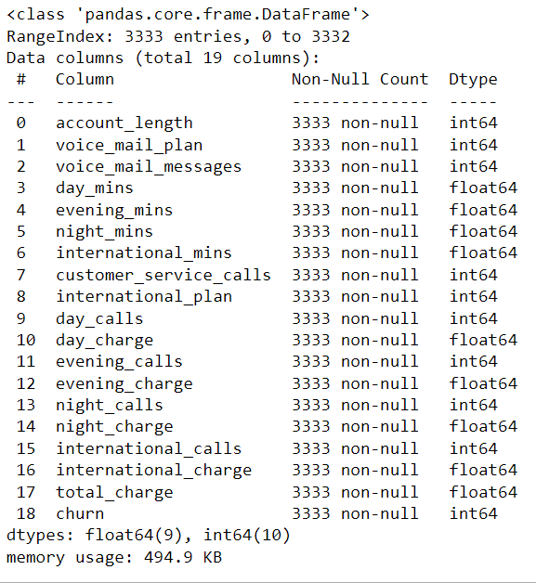
Dataset Details
3333 Observations & 19 Features
No Null values
No Duplicates
All Columns Data Type is Numeric(float/integer)

Slide 5
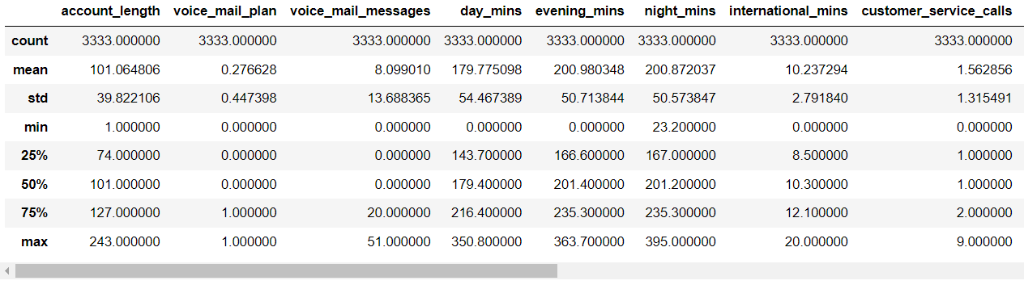
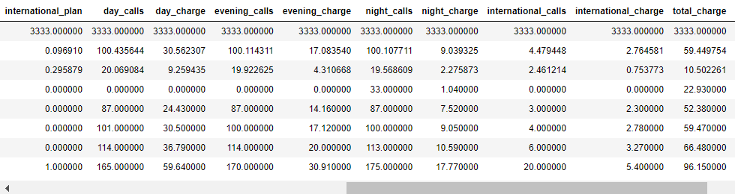
Data Description

Slide 6
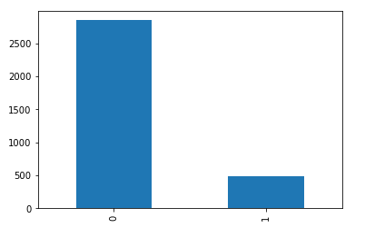
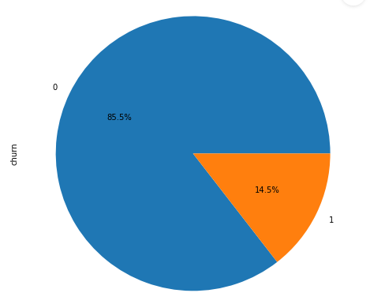
Distribution of churn and loyal customers(1-Churn, 0-No Churn)
Out of total customers 85.5% customers are loyal customer and 14.5% customer has left the company

Slide 7
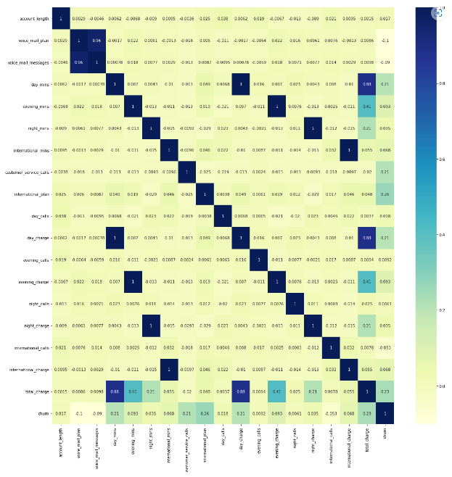
Correlation Matrix
High Correlation Between day_charge and day_mins, evening_charge and evening_mins, night_charge and night_min , international_charge and international_min, voice_mail_message and voice_mail_plan

Slide 8
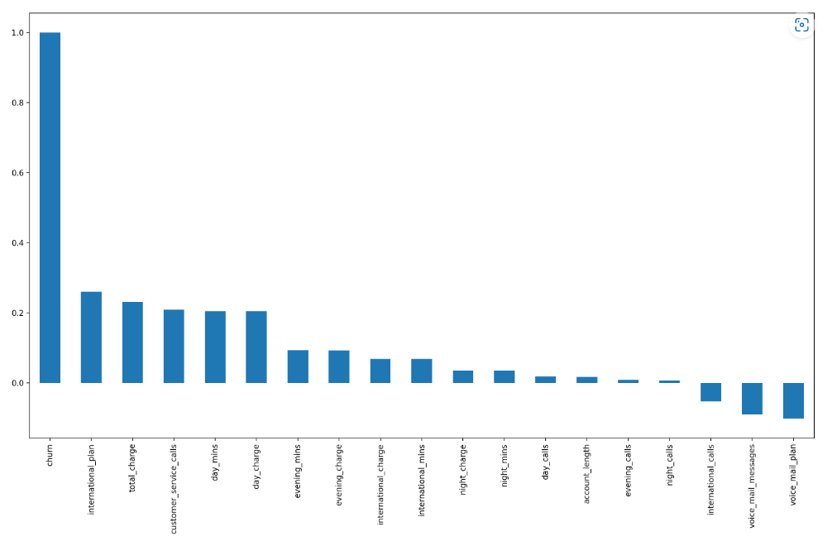
Correlation between different independent features and dependent feature (Churn)

Slide 9
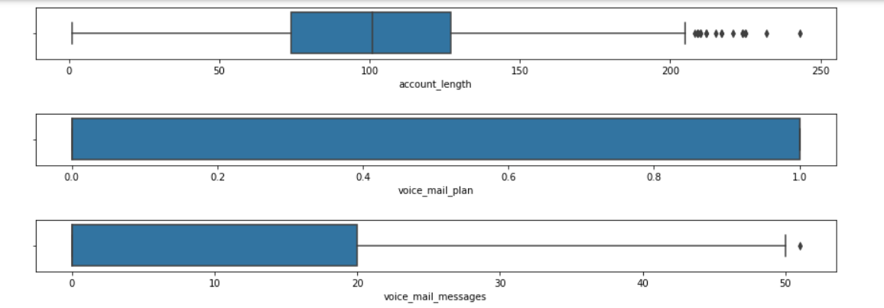
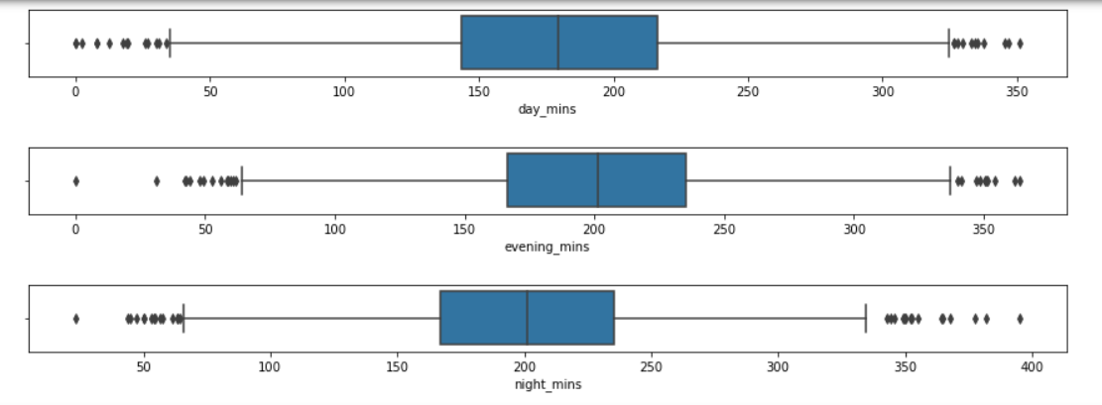
Box Plot for all variables

Slide 10
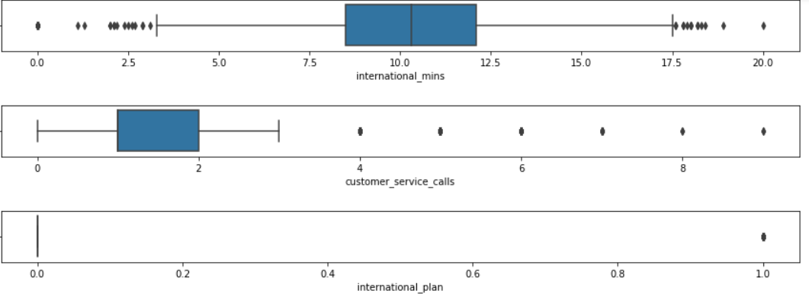
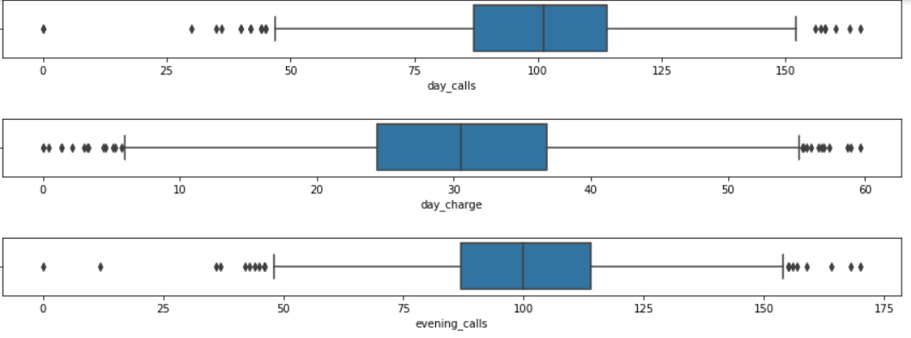
Box Plot for all variables

Slide 11
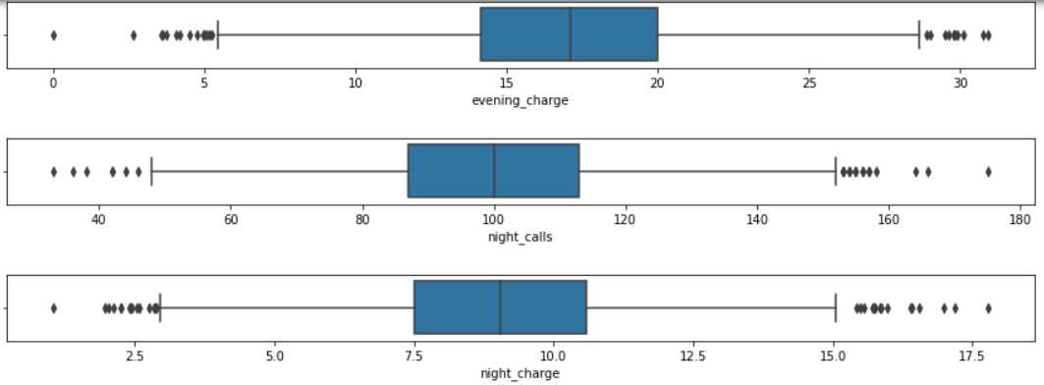
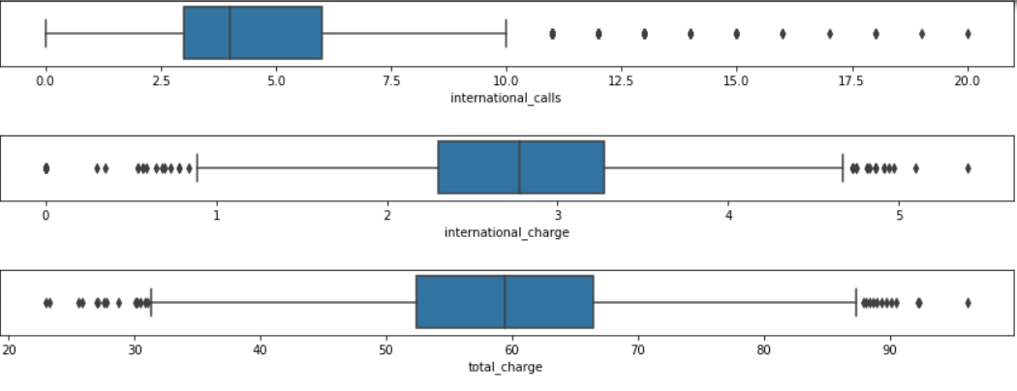
Box Plot for all variables

Slide 12
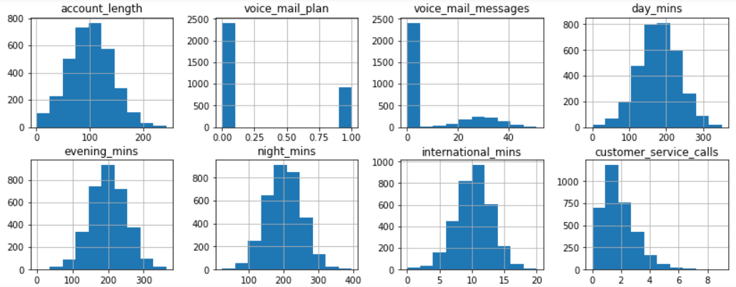
Histogram for all Variables

Slide 13
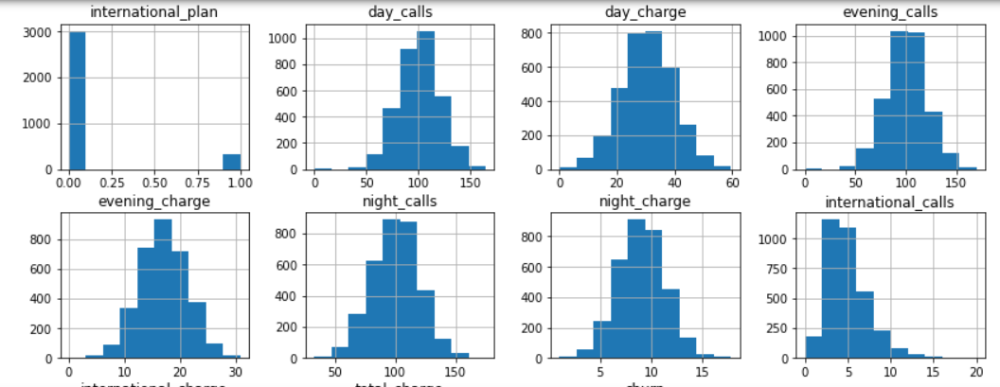
Histogram for all Variables

Slide 14
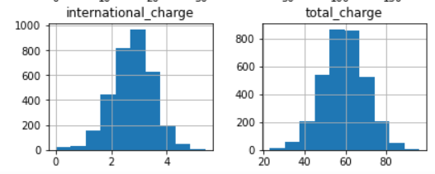
Histogram for all Variables
All features having outlier except voice mail plan
All features are normally distributed except voice mail plan, international plan and voice mail message.

Slide 15
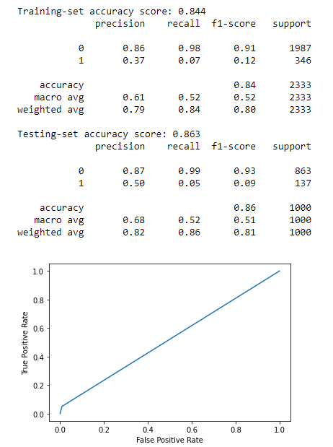
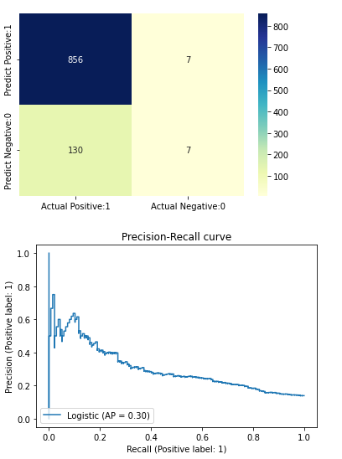
Logistic Regression Model Building before applying feature selection and Dataset balancing

Slide 16
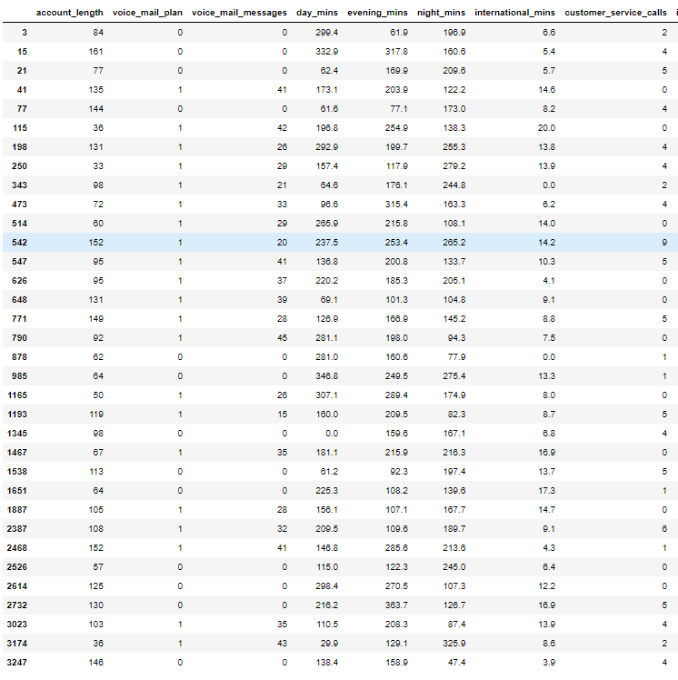
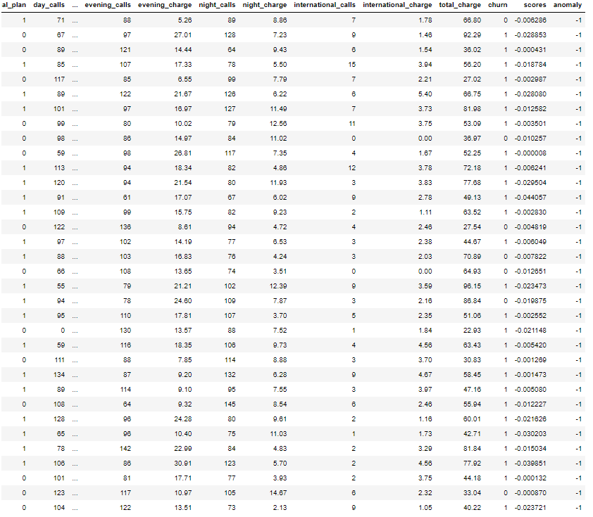
Outlier Detection using Isolation Forest

Slide 17
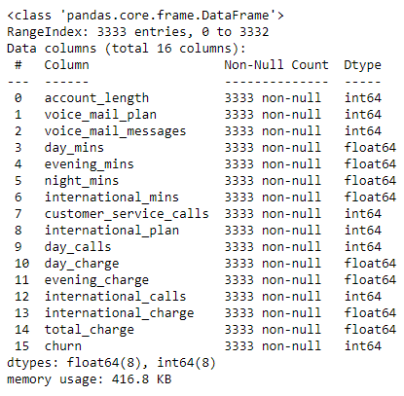

Feature Selection using Recursive Feature Elimination
Features that are less important
Data after removing less important features

Slide 18
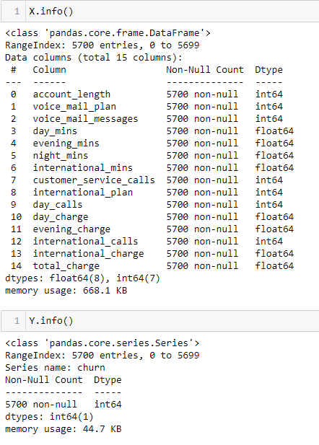

Dataset After Balancing
As target variable were not balanced SMOTE oversampling used for balancing the data.

Slide 19
Model Building using balanced dataset and selected features
Models
Logistic Regression
Random Forest
SVM
AdaBoost
XGBoost
Multinomial Naïve Bias
Gaussian Naïve Bias

Slide 20
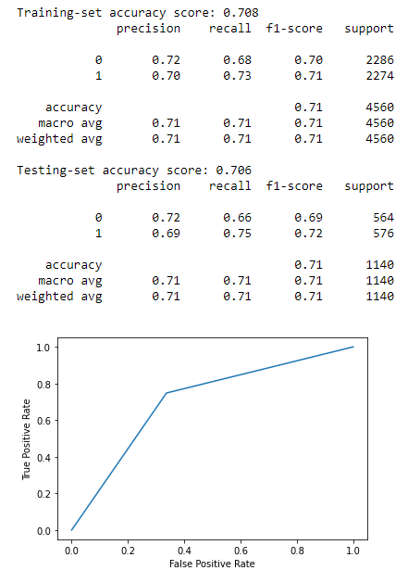
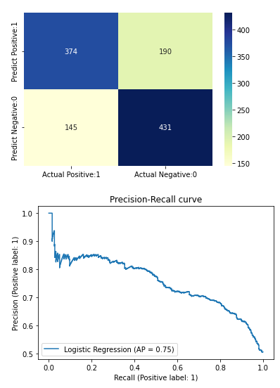
Logistic Regression

Slide 21
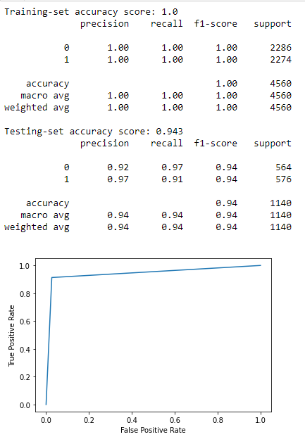
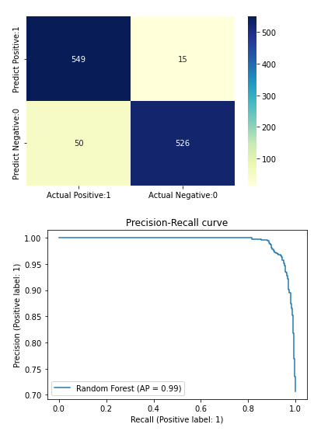
Random Forest

Slide 22
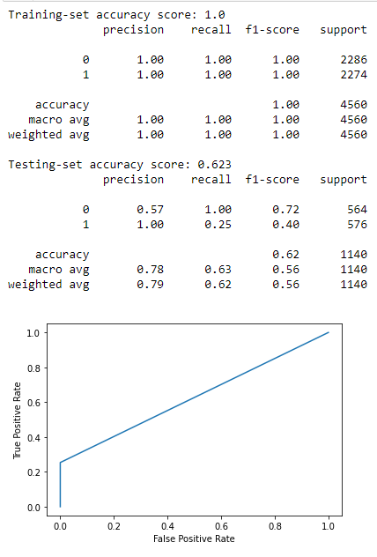
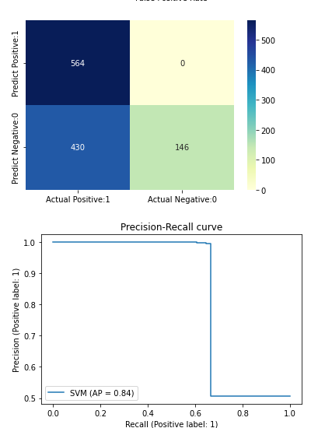
Support Vector Machine

Slide 23
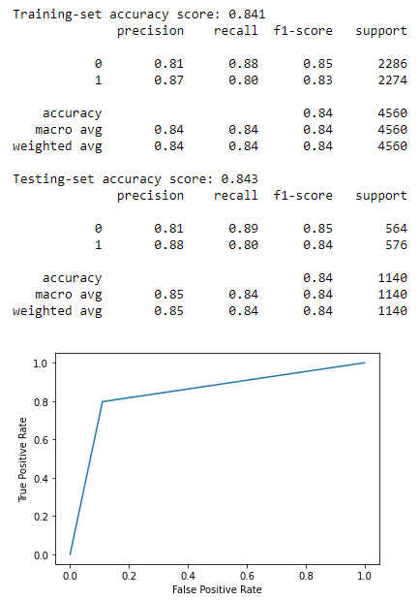
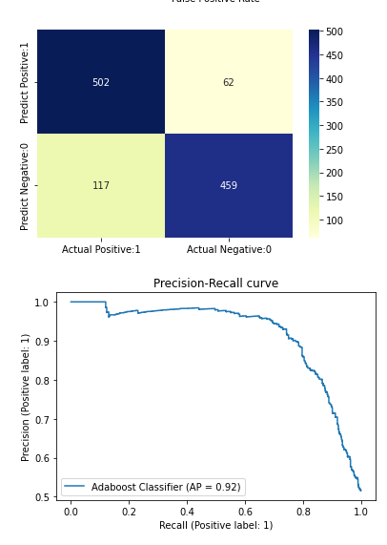
AdaBoost Classifier

Slide 24
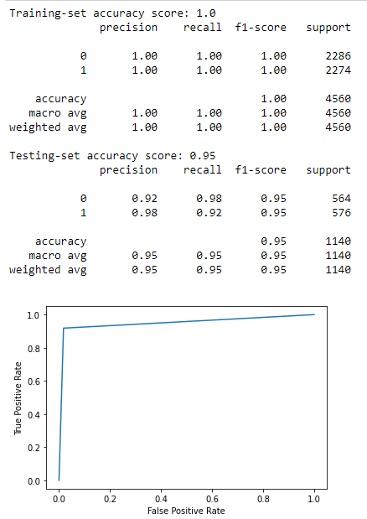
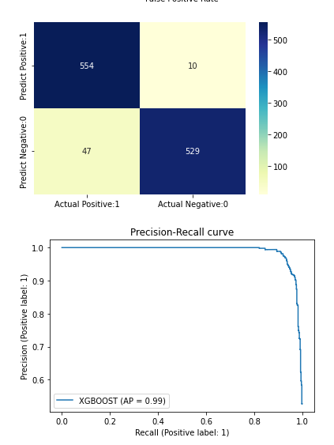
XGBoost Classifier

Slide 25
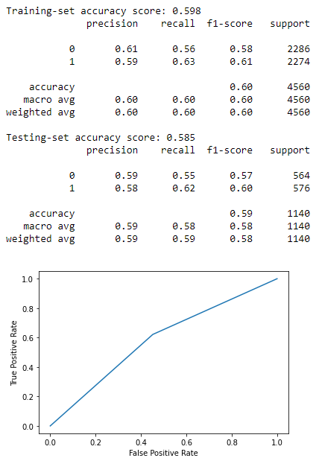
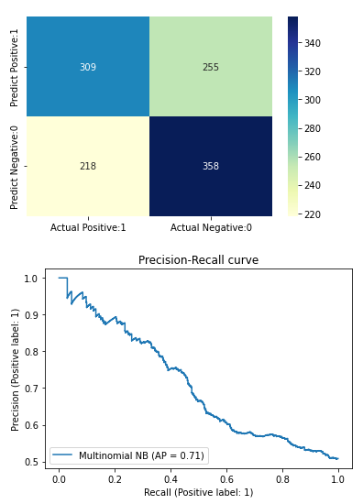
Multinomial Naive Bayes

Slide 26
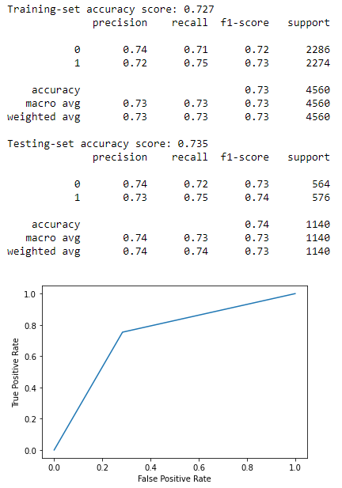
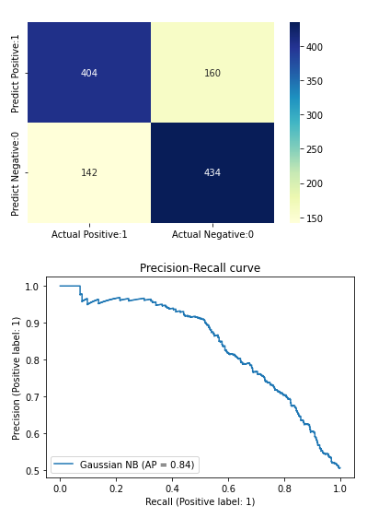
Gaussian Naïve Bayes

Slide 27
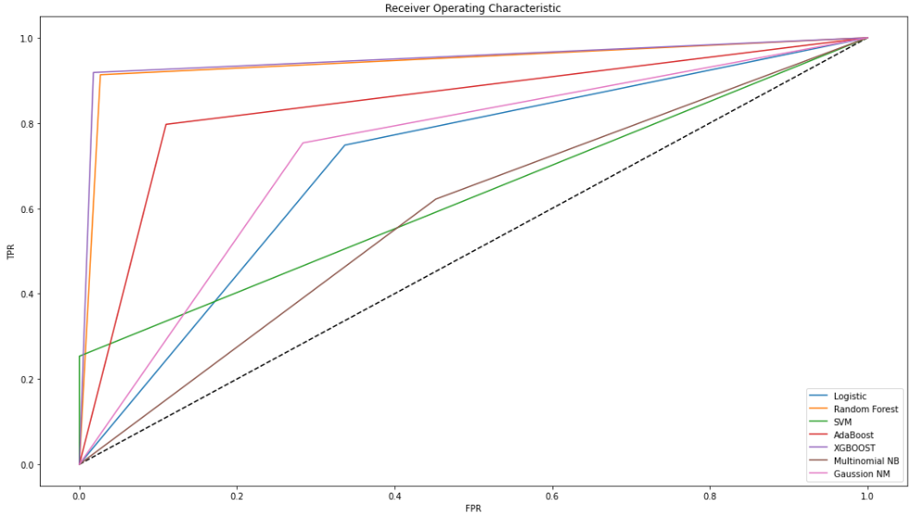
Roc Auc Curve
XGBoost and Random Forest both are giving good result

Slide 28
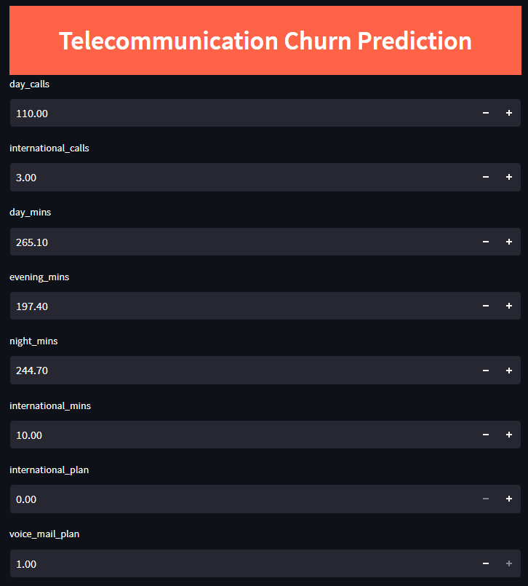
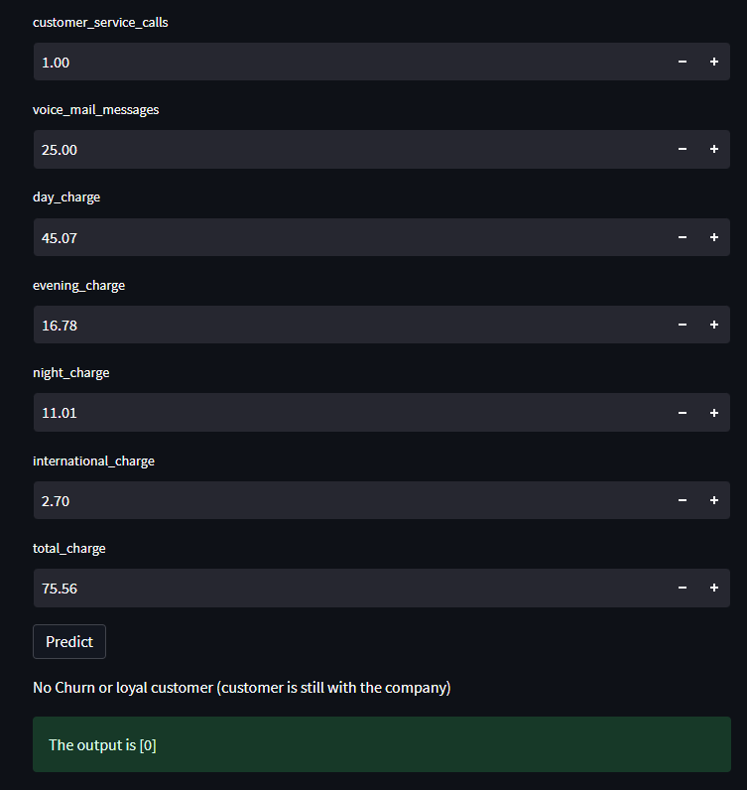
Model Deployment Using Random Forest
Prediction of output 0 means no churn or loyal customer

Slide 29
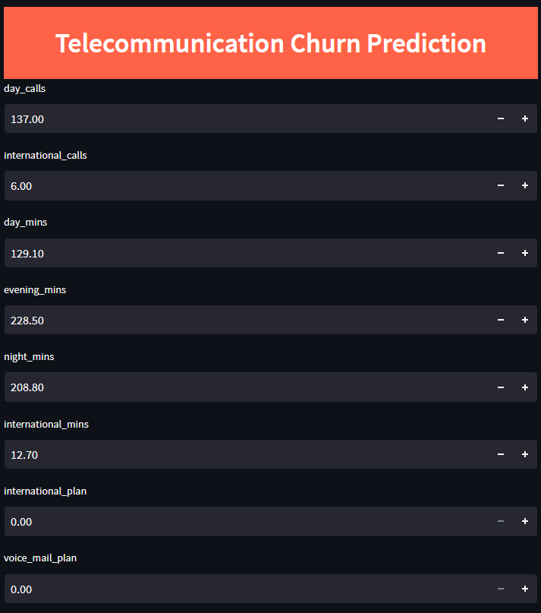
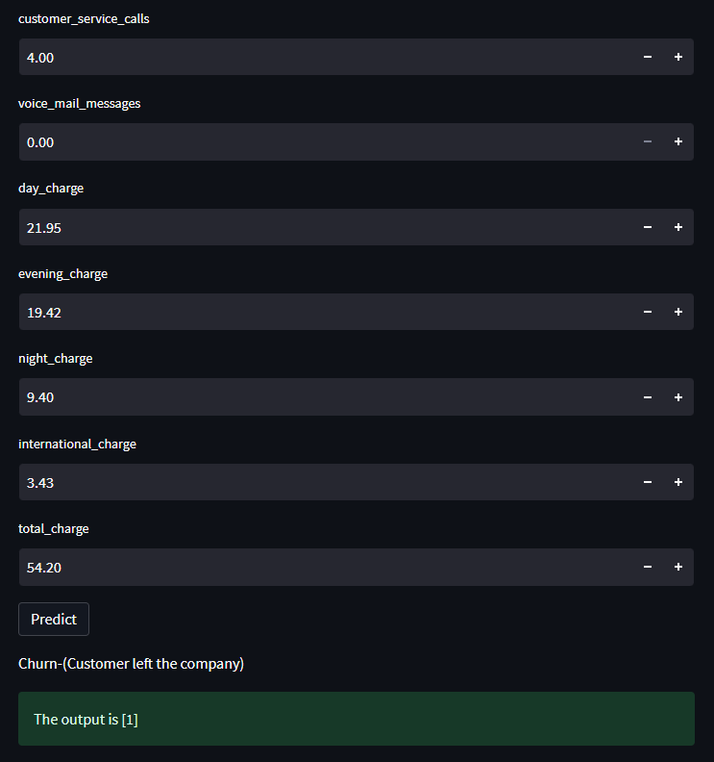
Prediction of output 1 means churn or customer has left the company

Slide 30
Conclusion
Bases on the prediction given by the model
Output 1 means Churn or customer has left the company
In order to retain the customers, telecom providers should come up with some offers and special recharge packages
Thank-you

